Slide 1
CSCI 6234 Assignment
Group 10:
Mingqian Liu
Zhibo Sheng
Kai Wang
Junwen Wen

Slide 2
Actors
User: watchers and moderators
Movie API Server: provide movie server to system

Slide 3
Use Cases
Create watcher group: moderator creates watcher group
Invite to group: moderator invites users to watching group
Join a watcher group: users join a watcher group
Unsubscribe watcher group: users unsubscribe watcher group
Populate movies: moderator populates movies
Pull movie list: moderator pulls movie lists from API server
Search and browse movies: users search and browse movies
Watch the trailer: users watch the trailer

Slide 4
Use Cases (continued)
Access to movie reviews: users access to movie reviews
Create a movie watching event: moderator creates a movie watching event
Open and close a voting: moderators open and close a voting
Notified by events and voting: users are notified new events and voting
Cast votes: users cast votes for movie

Slide 5
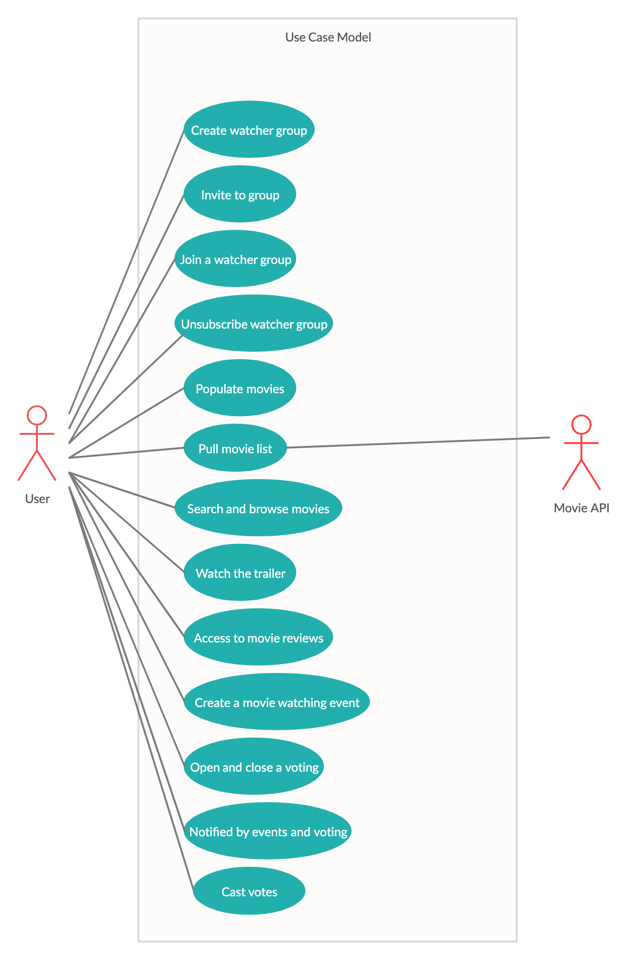
Use Case Diagram

